Slide 1




Evaluate Survey Data-Collection Methods

Slide 2
CE4 – iClicker poll – which option would you choose? And why?
The Red Lion, Ltd., is a chain Of 13 bar-restaurants located in seven major cities on the east coast. The original Red Lion was opened in 2003 by Albert Campion, an English expatriate. The chain is modeled after the typical English pub. Much Of the equipment and furnishings have been collected from actual pubs throughout the British Isles. The Red Lion sells typical English dishes such as fish and chips and kidney pie, as well as a variety of sandwiches and a selection of American and English beers. In addition, Mr. Campion claims to have the largest collection Of Scotch whiskeys outside Of the British Isles.
Mr. Campion feels that "the key to the successful operation of a pub is the maintenance of a friendly, intimate ambience." He would like to personally oversee the operation of each pub, but that has become impossible as the chain has grown. Because of this, Mr. Campion has invested in hiring top quality managers, most Of whom are from England. Despite the care Mr. Campion has taken, he still feels that he needs some mechanism to ensure that the food and service are of a consistently high quality. TO this end, Mr. Campion is considering four alternative forms of marketing research:
A short questionnaire is placed on each table. Customers who have criticism, praise, or suggestions are asked to complete the form and give it to their server.
A trained interviewer visits each pub on an unannounced basis. Selected customers are interviewed as they are leaving the pub.
Mr. Campion contracts With a customer experience firm. At the bottom of each customer's receipt is the link to an online survey customers can complete and receive a discount on their next visit to the pub.
None of the above. Instead rely on posts to sites like Yelp and Facebook to assess customer satisfaction
Discuss the merits of these alternatives and indicate which, if any, you would recommend to Mr. Campion

Slide 3

Questions for CE4
1. Which of these forms of marketing research do you think would have the highest response rate?
2. Would doing these questionnaires, interviews, customer experiences inflict specific biases? How to deal with those bias?

Slide 4

Survey
A survey involves interviews with a large number of respondents using a predesigned questionnaire

Slide 5

Advantages of Surveys
Standardization
Ease of administration
Ability to tap the “unseen”
Suitability to tabulation and statistical analysis
Sensitivity to subgroup differences

Slide 6
Disadvantages of Surveys
Self-selection bias
Non-response bias
Measurement error:
random
non-random
iClicker poll: Are you a good driver?
above b) average c) below
Notes:
Those who respond are probably different from those who do not respond

Slide 7
Survey Methods
Person-administered survey
Computer-administered survey
Self-administered survey
Mixed-mode (hybrid) surveys
Notes:
Four basic survey methods:

Slide 8
Survey Methods
Person-Administered Survey: An interviewer reads questions, either face-to-face or over the telephone, to the respondent and records his or her answers. E.g., telephonic interview
Computer-Administered Survey: Computer technology plays an essential role in the interview work. E.g., Online questionnaire

Slide 9
Survey Methods
Self-Administered Survey: The respondent completes the survey on his or her own. (e.g., Mail survey)
Mixed Mode: A combination of two or more methods

Slide 10
Person-Administered Survey
Advantages
Feedback
Rapport
Quality Control
Adaptability
Disadvantages
Human make errors
Slow speed
High Cost
Interview Evaluation

Slide 11
Self-Administered Survey
Advantages
Reduced cost
Respondents control the pace
No-interview evaluation
Disadvantages
Delays
Lack of monitoring

Slide 12
Choice of Survey Method
Time horizon
Cost and budget
Infrastructure
Type of respondent
Perceived anonymity
Notes:
Depends on multiple factors

Slide 13
Recap
Advantages and Disadvantages of surveys?
Different ways to collect survey data? Associated advantage and disadvantages?

Slide 14
Overview of a Survey Design
Introduction & Instruction
Format and layout
Transition to different sections
Flow of the survey
Translate RQ to QQ
Description of Decision alternatives
Response options/ level of measurement

Slide 15
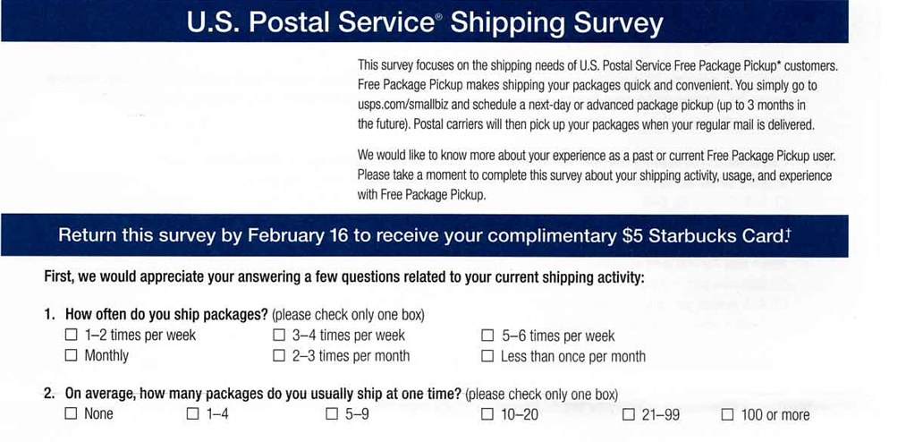
Introduction

Slide 16
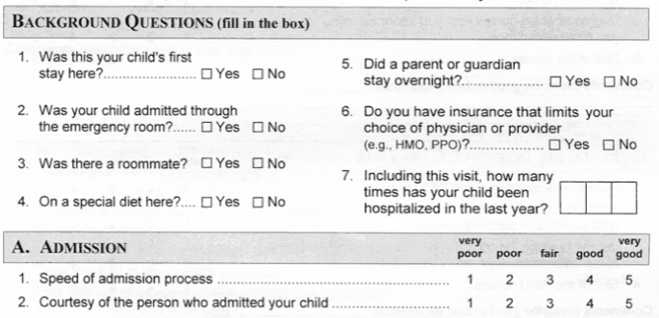
Format and Layout

Slide 17
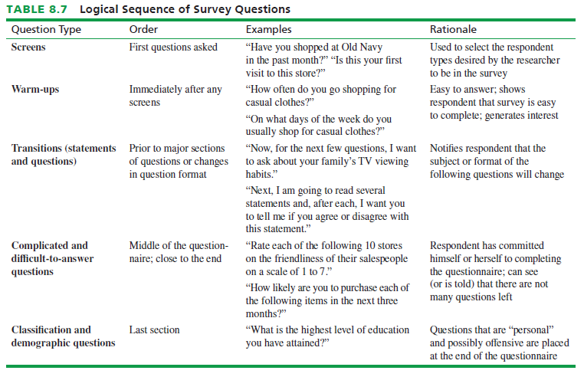
Flow of the Survey

Slide 18
Translate RQ to QQ – iClicker how would you translate the RQ into QQ?
RQ: What percent of current customers would like a larger selection at the bookstore?
QQ: The selection of books at this store is....
__ too small __about right __larger than I need
RQ: How likely are customers to use a coffee bar if it was added to the bookstore?
QQ: If an upstairs coffee bar was added to the bookstore, how often would you use it?
__most times I visit the store
__sometimes when I visit the store
__rarely
__never
RQ: What improvements would customers like to see at the bookstore?
QQ: Are there any changes you'd like to see made to the bookstore?
If so, please describe

Slide 19
To do
PA3: I will grade the PA3 based on the revised version
Qualtrics homework
PA4

Slide 20
PA4
Questionnaire Design Steps
Write the Questions
For each research question (RQ):
1. Identify the variable(s) to measured
2. Decide level of measurement for each variable
3. Write the question and response
Organize the Questionnaire
4. Design the introduction
5. Arrange questions in order
6. Number the questions
Evaluate the Questionnaire
7. Evaluate the questions with respect to the RQs
Worksheet A
Worksheet B
8. Pretest the questionnaire; revise as needed
9. Obtain client approval
10. submit

